Slide 1
Classes and pointers
(with constructor and destructor)
Both derived data types and interact with each other
  A pointer can point to a class object
  A class can have pointer as data member

Slide 2
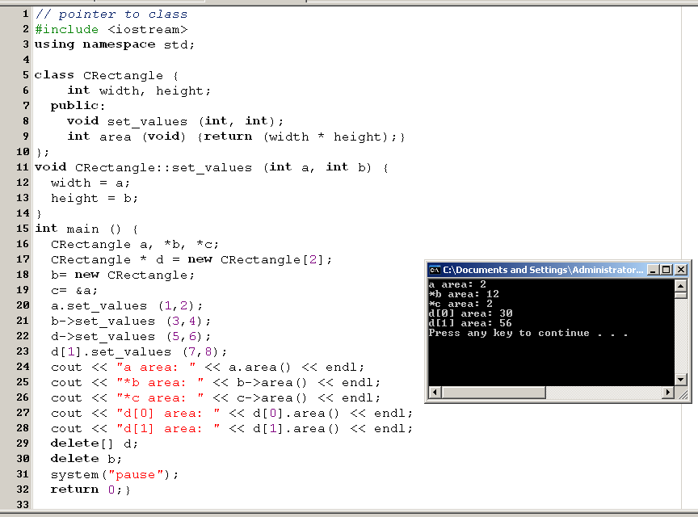
Pointers to Class

Slide 3
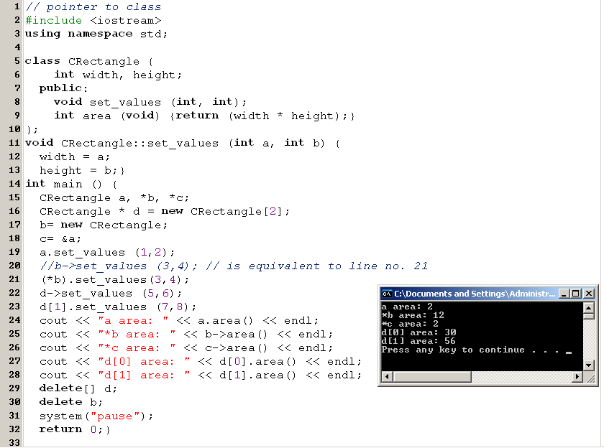

Slide 4
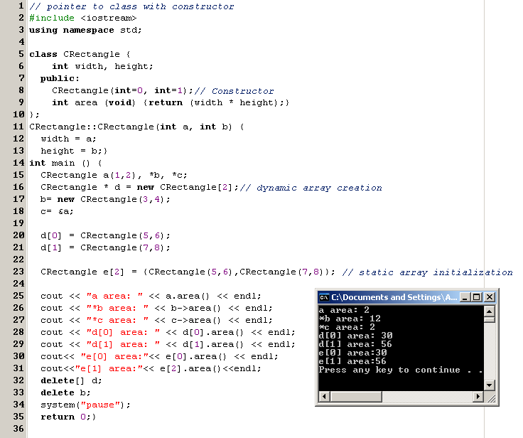

Slide 5
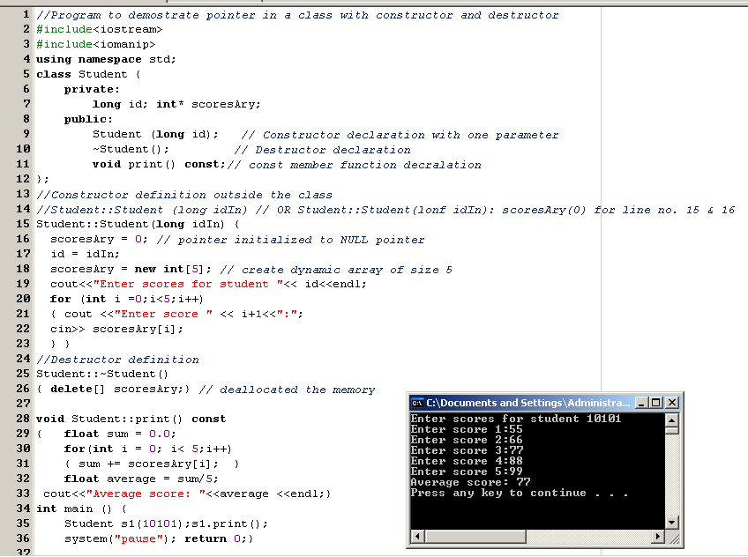

Slide 6
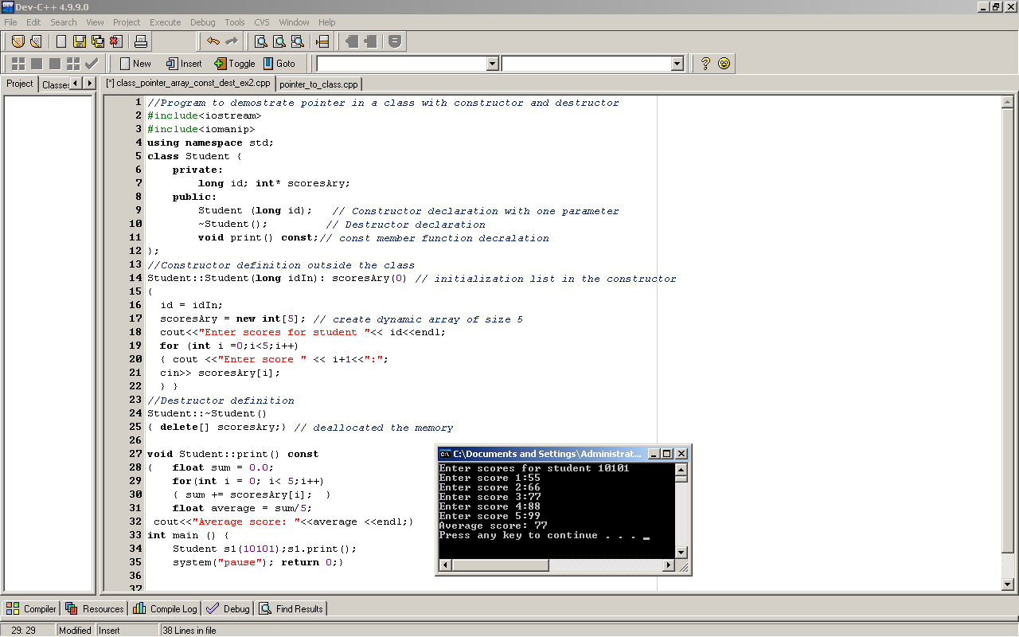

Slide 7


Example:
  A pointer found in a class is a class that uses dynamic memory.
  Whenever we allocate memory we use a pointer
  We create a student class that uses a dynamically allocated array to store the students scores
Student object

Slide 8
Two important concepts in the previous example
  In the constructor we dynamically allocate memory for the array
  For integrity we use an initialization list in the constructor to initialize the pointer scoresAry to 0
  It is a good programming technique for classes that use dynamic memory
  We release array memory in the destructor so that dynamic memory doesn’t become fragmented

